Slide 1

HEAP SORT
Group Members
Fuzail Raza 39091
Waqas Zafar 38605
Abdul Quddous 36154

Slide 2


Introduction to Heap Sort
Heap sort is a comparison-based sorting technique that uses a binary heap data structure. It was first proposed by J. W. J. Williams in 1964. The algorithm divides its input into a sorted and an unsorted region, and it repeatedly selects the maximum element from the unsorted region and moves it to the sorted region.

Slide 3
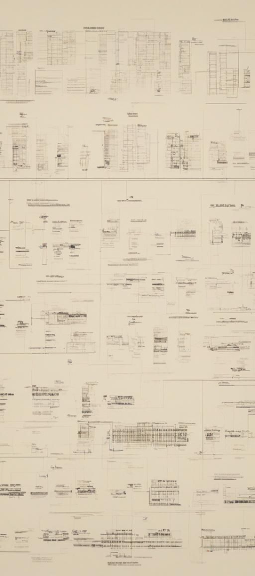
What is Heap and History of Heap Sort
1
Definition of Heap
A heap is a specialized binary tree-based data structure. It is a nearly complete binary tree which satisfies the heap property.
2
History of Heap Sort
Heap sort was first proposed by J. W. J. Williams in 1964. It's an in-place sorting algorithm, and it's also not stable, which means it does not preserve the relative order of equal elements.

Slide 4

Algorithm for Heapify
1
Heapify Process
2
Complexity of Heapify
Heapify is a process of arranging the elements in the heap, so that the given array becomes a heap. It starts from the last non-leaf node and goes backward up to the root node.
The time complexity of heapify is O(log n) where n is the number of nodes in the heap. It is a crucial step in the construction and manipulation of the heap data structure.

Slide 5
Algorithm for Heap Sort
Heap Sort Step 1
Heap Sort Step 2
Heap Sort Step 3
Build a heap from the input data. It rearranges the elements into a heap, so the largest element is at the root.
Swap the first and the last element in the heap, then decrease the size of the heap by 1, and heapify the root of the tree.
Repeat step 2 until the whole heap is sorted.

Slide 6
Best Case, Worst Case, and Average Case Analysis
O(n log n)
O(n log n)
O(n log n)
Best Case
Average Case
Worst Case
The best-case time complexity of heap sort is O(n log n), where n is the number of elements in the input array.
The average-case time complexity of heap sort is O(n log n) as well, making it a consistent performer under normal conditions.
The worst-case time complexity remains O(n log n), ensuring that heap sort is efficient in most scenarios.

Slide 7
Time and Space Complexity Analysis
Algorithm
Best Case
Average Case
Worst Case
Heapify
O(n)
O(n)
O(n)

Slide 8
Time and Space Complexity of Heapify
Time complexity of O(log n)
Space complexity of O(1)

Slide 9
Techniques Used in Heap Sort
Heap Property
Recursive Approach
One of the core techniques used in heap sort is maintaining the heap property by adjusting elements when necessary to ensure the largest (or smallest) element is at the root.
Heap sort uses recursion in the heapify step to efficiently organize and sort the elements in the input array.

Slide 10



Applications of Heap Sort
Priority Queues
Operating Systems
Heap sort is widely used to implement priority queues due to its efficient nature in maintaining the order of elements based on their priority levels.
Heap sort is also used in memory management systems within operating systems to efficiently allocate and deallocate memory resources.

Slide 11

Advantages and Disadvantages of Heap
Advantages
Disadvantages
Heaps are efficient for finding the maximum or minimum element of a collection, making them suitable for priority queue applications.
Heap data structures can be challenging to modify or update dynamically, which limits their applicability in certain scenarios.

Slide 12

Conclusion
1
Efficient Sorting
2
Wide Applications
Heap sort, with its consistent O(n log n) time complexity and in-place sorting nature, remains a valuable sorting algorithm in various applications.
Its efficient nature and applications in priority queues and memory management systems make it a crucial algorithm in computer science.

Slide 13

Thank You
Any Question

